Slide 1
Smart Indoor Parking System
The Tech Sense
CENG-322 Deliverable 5 Presentation
6th December 2024

Slide 2
Team Introduction
Team Name: The Tech Sense
Team Member :
1- Raghav Sharma (Leader)
2- Kunal Dhiman
3- Rushi ManojKumar Patel
4- NisargKumar PareshBhai Joshi

Slide 3
Project Description
The “Parkit” app allows users to easily search and reserve parking spots. Users can save their favorite parking locations for quick access and take advantage of special offers and discounts through promotions. The app also includes a feedback feature to help improve services and a notification system to provide important updates. Additionally, users can make secure, real-time payments.
For parking lot owners, the app offers a dashboard to view recent activities and the ability to add or update parking location details. Owners can track their income and benefit from the real-time payment system.

Slide 4
Why Your Project is Unique
Our project stands out due to its dual-interface design, catering to both users and parking lot owners. This approach offers a comprehensive set of features, including real-time slot management for adding and removing parking spaces. Additionally, our secure payment system ensures all transactions are processed in real-time, providing a seamless and trustworthy experience for both parties.

Slide 5
App Comparison with Market Apps
Dual Interface Design:
Park It uniquely offers separate interfaces for users (parking spot bookers) and owners (parking lot managers).
No other apps in the market provide this dual-interface functionality.
IoT-Driven Features:
Real-time data from IoT sensors, temperature, and passkey validation via keypads, ensures higher security and a smarter indoor parking experience.

Slide 6
Demo of the App and Flows

Slide 7
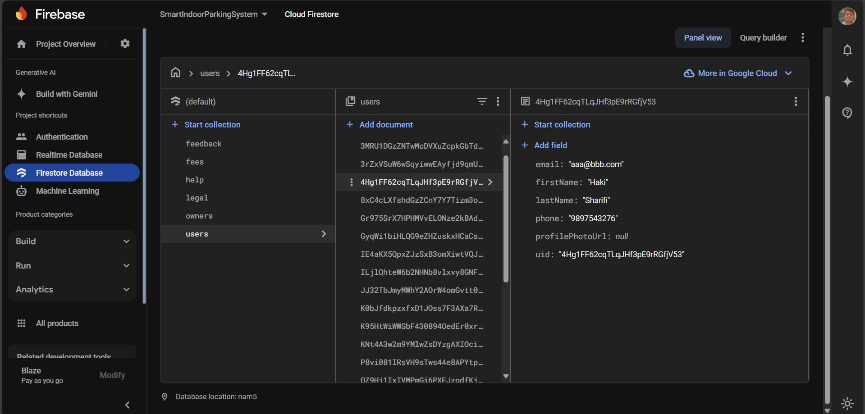
Backend DB Demo
ParkIt Firebase database

Slide 8
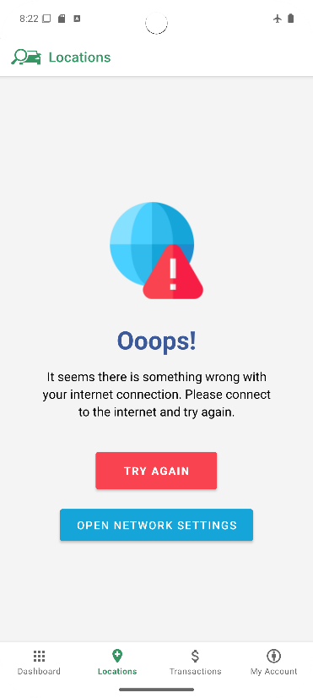
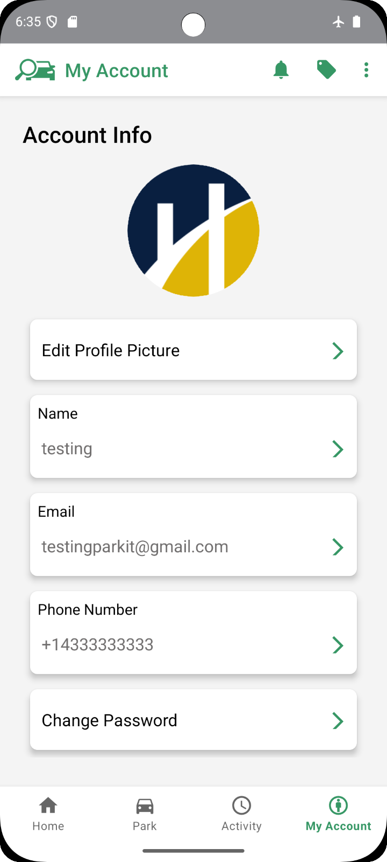
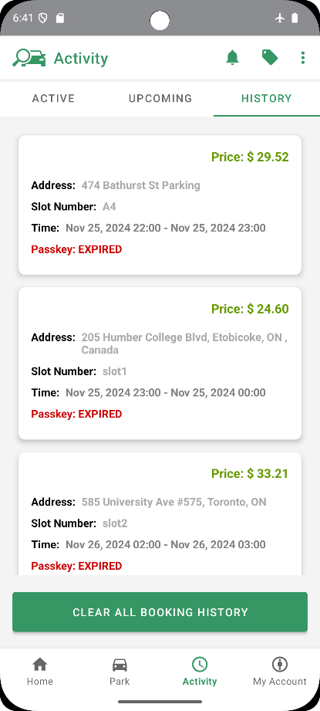
Offline Mode Demonstration

Slide 9
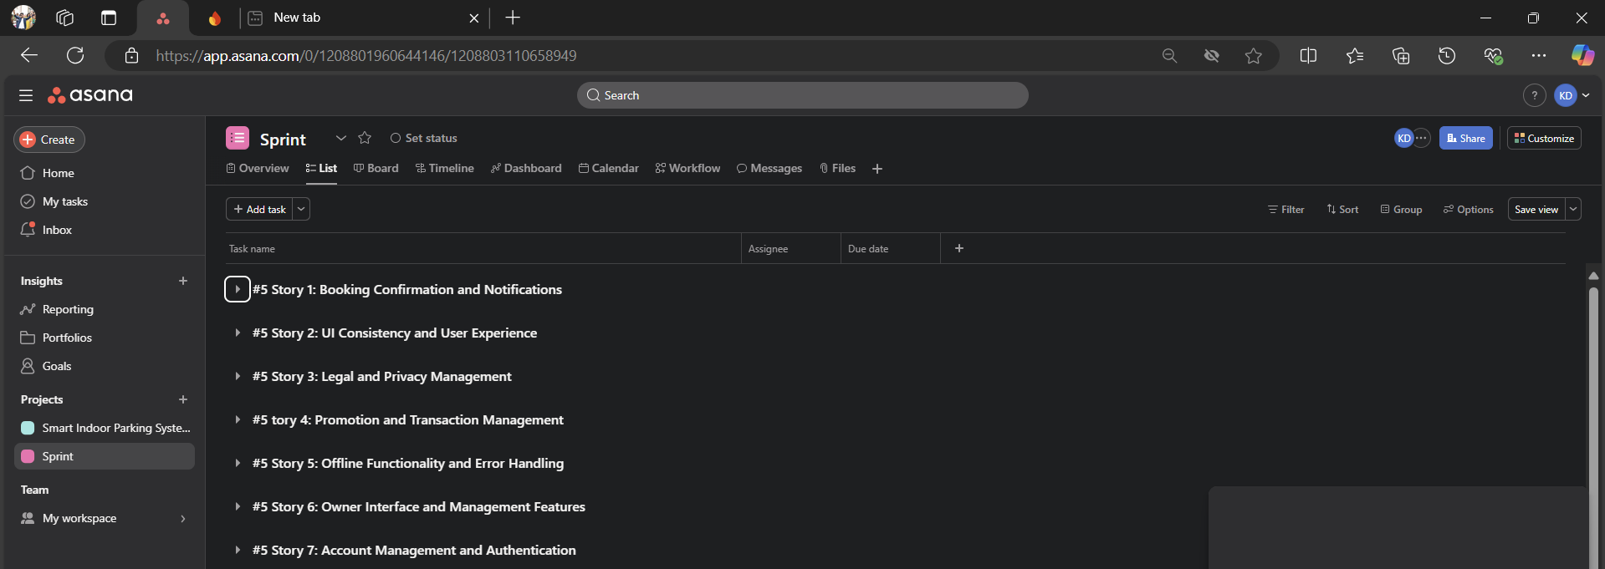
Sprint Dashboard
ParkIt Sprint Dashboard

Slide 10
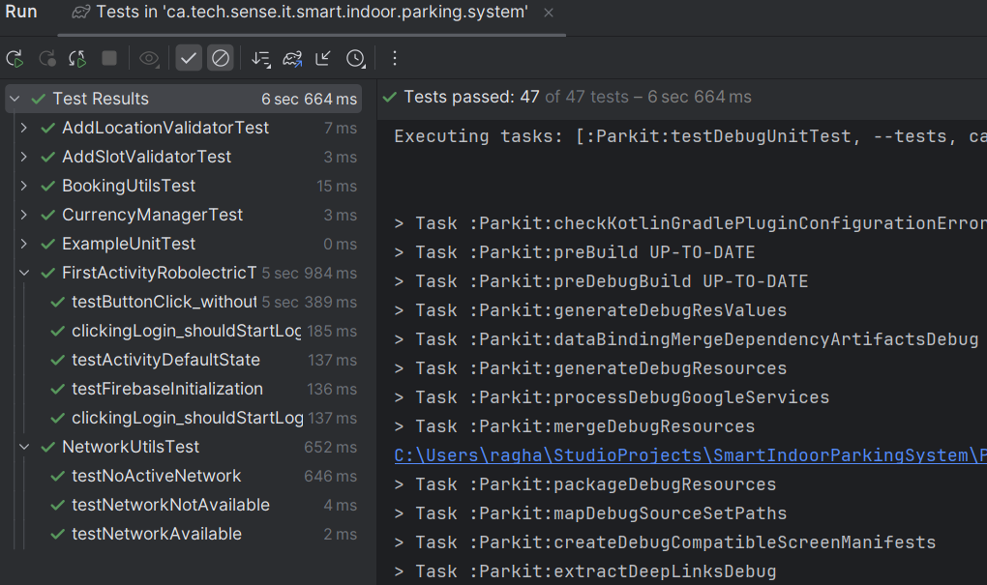
Test Cases

Slide 11

Q&A

